Slide 1
Investment Portfolio Optimisation (LP and ILP)
GOKUL BASKAR

Slide 2
Introduction
Purpose: Optimize an 8-asset investment portfolio to maximize returns while managing risk. The task uses real ASX stock data to demonstrate portfolio modelling techniques.
Approach: Used historical monthly returns (Jan 2021 – Jan 2025) for 8 selected stocks and formulated two optimisation models – a Linear Program (LP) and an Integer Linear Program (ILP). The LP allows fractional investment in each asset, while the ILP restricts to choosing a subset of assets.
Tools: Microsoft Excel and Solver were used to implement the models. Constraints were derived from diversification and risk requirements. Solver’s Simplex LP algorithm (and branch-and-bound for ILP) identified the optimal allocations. Sensitivity analysis was conducted on the LP model to interpret constraint impacts.

Slide 3
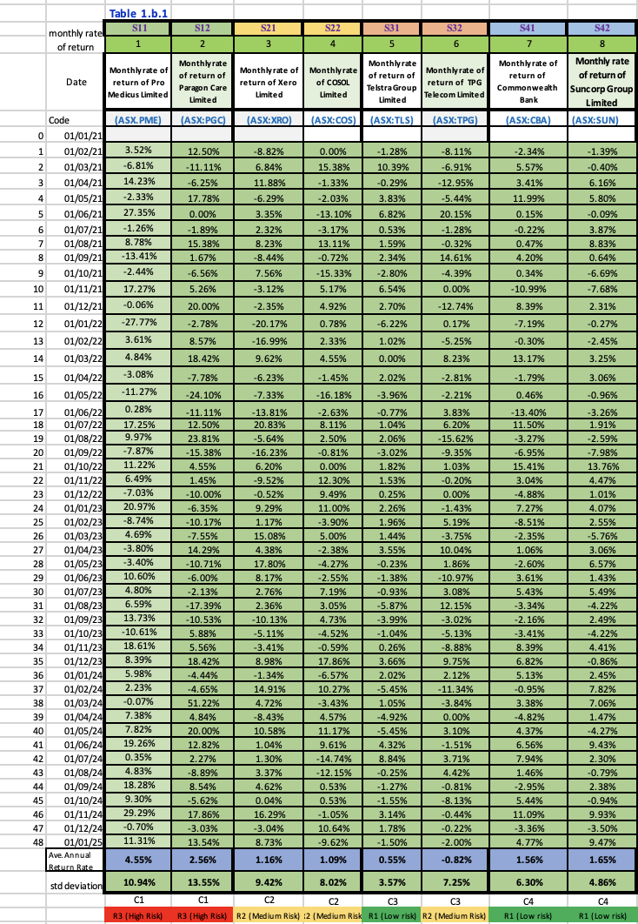
Asset Selection by Sector
Chose 8 ASX-listed stocks across 4 sectors (2 stocks per sector) to ensure broad industry representation:
Health Care (S1): Pro Medicus (PME) and Paragon Care (PGC)
Information Technology (S2): Xero (XRO) and Cosol Ltd (COS)
Communication Services (S3): Telstra (TLS) and TPG Telecom (TPG)
Financials (S4): Commonwealth Bank (CBA) and Suncorp (SUN)
Each sector includes one given stock and one chosen stock.
This provides a mix of large-cap and mid/small-cap companies. All selected stocks had 48 months of price data up to Jan 2025.
Rationale: Selecting one stock from each major sector ensures the portfolio is not over-concentrated in any single industry, aligning with the diversification requirement.

Slide 4
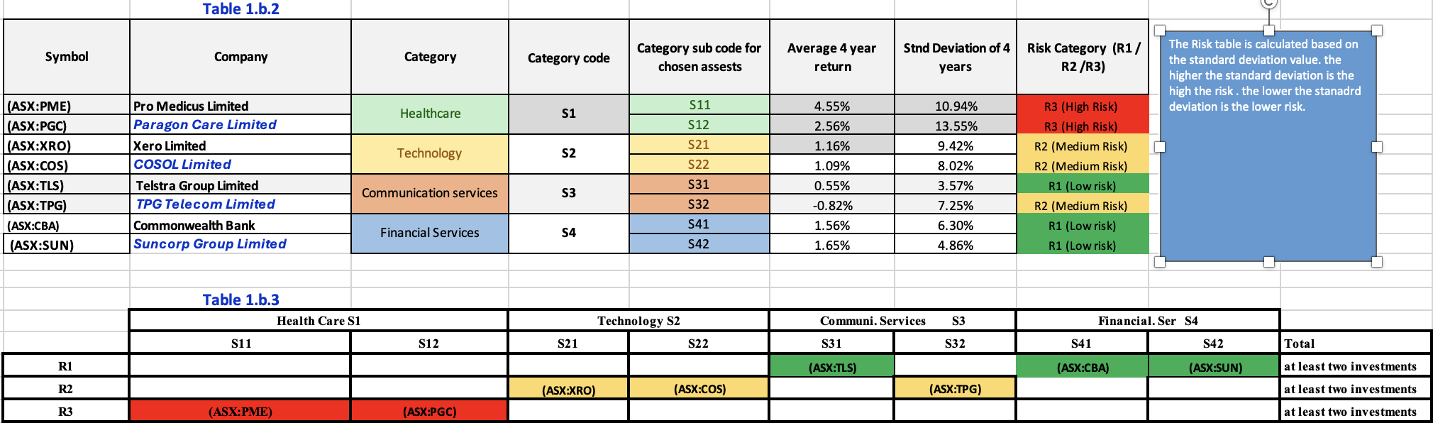
Risk Classification (R1, R2, R3) :
Classified the 8 stocks into three risk groups based on their return volatility (standard deviation):
R1 (Low Risk): Lowest volatility stocks – TLS, CBA, SUN. These are large, stable firms with relatively steady returns.
R2 (Medium Risk): Moderate volatility stocks – PME, XRO. These growth-oriented companies exhibit higher fluctuation but not the highest risk in the set.
R3 (High Risk): Highest volatility stocks – PGC, COS, TPG. Smaller or more volatile companies with the most uncertainty in returns.
Justification: Calculated each stock’s monthly return std. dev. and ranked them. Cut-off values were chosen to create three tiers (R1 < R2 < R3) with at least two stocks in each tier​. This ensures the portfolio contains a spread of risk levels.
Risk Group Ranges: R1 assets had the lowest standard deviations (most stable), R3 assets the highest. For example, defensive stocks like Telstra and CBA fell in R1, whereas a small-cap tech stock (COS) and telecom challenger (TPG) were R3 due to higher volatility. This grouping informed the risk constraints in the models.

Slide 5
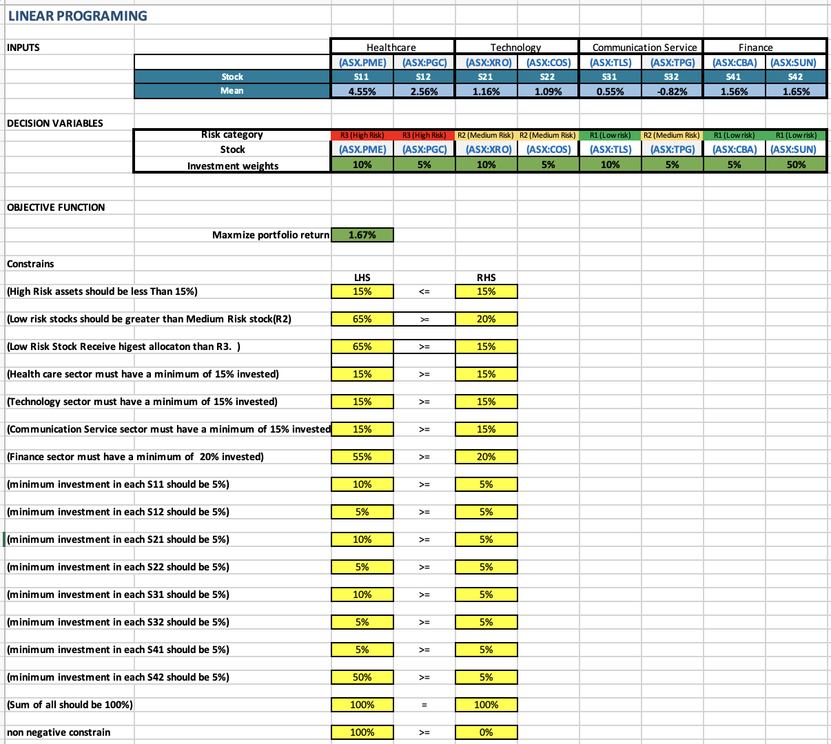
Linear Programming Model – Optimal Solution
Optimal portfolio allocation under the LP model (proportion of total investment per asset). The solution heavily allocates to Suncorp (50%), while several assets are kept at the minimum 5% allocation due to constraints.
Optimal Weights: The LP optimization distributes the 100% as follows: SUN 50%, PME 10%, XRO 10%, TLS 10%, and 5% each to PGC, COS, TPG, CBA. The portfolio’s expected return is 1.67% under this allocation .
Feasible and Optimal: Solver found that all constraints are satisfied with this allocation (100% invested, all sector minima met, R3 sum = 15% exactly, etc.). Every asset received at least the 5% minimum, and higher weights were given to those with better return-to-risk trade-offs.
Portfolio Characteristics: The solution is highly diversified but not equal-weighted – one low-risk Financial stock (Suncorp) dominates the portfolio at 50%. This occurred because Suncorp had a relatively high average return for a low-risk stock, so the model allocated as much as allowed to it. Other sectors (Health, Tech, Comm) are each exactly at 15% (the minimum required for those sectors, comprised of 10%+5% among their two stocks). High-risk assets (PGC, COS, TPG) together sum to 15%, hitting the R3 cap. Essentially, the LP put extra weight on safe, higher-return assets (like SUN) and only the minimum on riskier or lower-return assets.
Every sector is represented (Health:15%, IT:15%, Comm:15%, Finance:55%), and the risk profile skews conservative: total R1 = 65%, R2 = 20%, R3 = 15%. This aligns with the constraint that R1 ≥ R2,R3, indicating the lowest-risk group holds the largest share of the portfolio (mainly via SUN and CBA’s allocations).

Slide 6
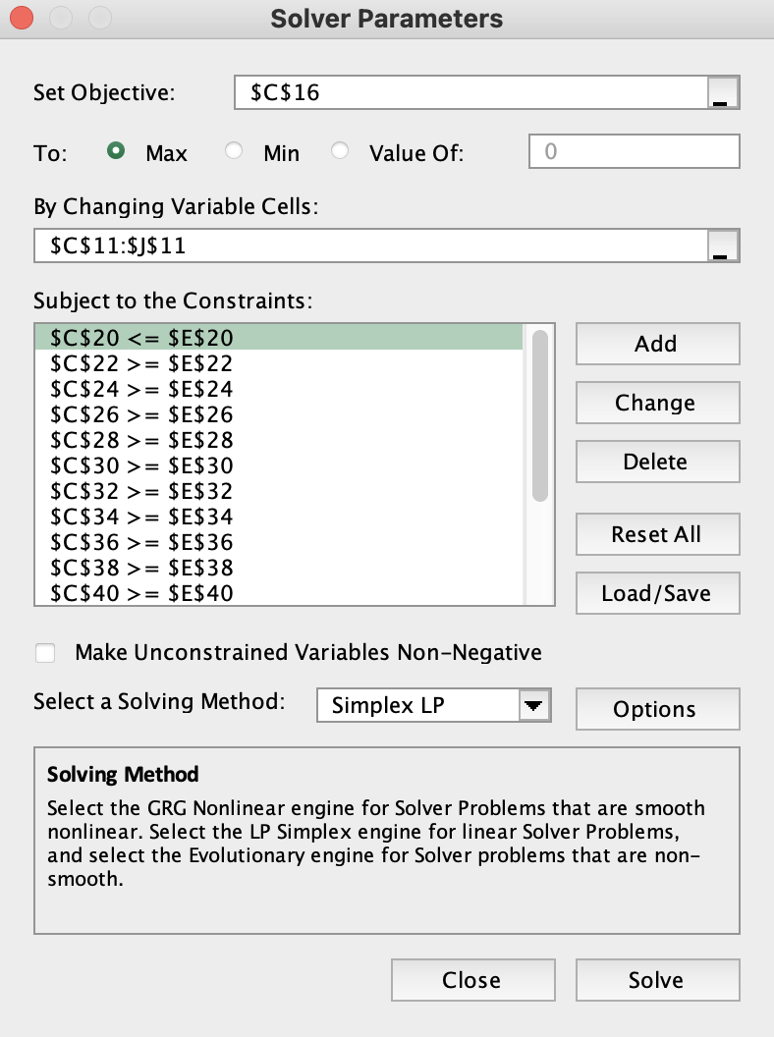
LP Model – Solver Setup
Within this linear model, the solving approach used is the Simplex LP method.
The list of constraints ensures that the model adheres to all required conditions (such as risk and sector allocations), and “Simplex LP” is the chosen solving method because it efficiently handles linear optimization problems.

Slide 7
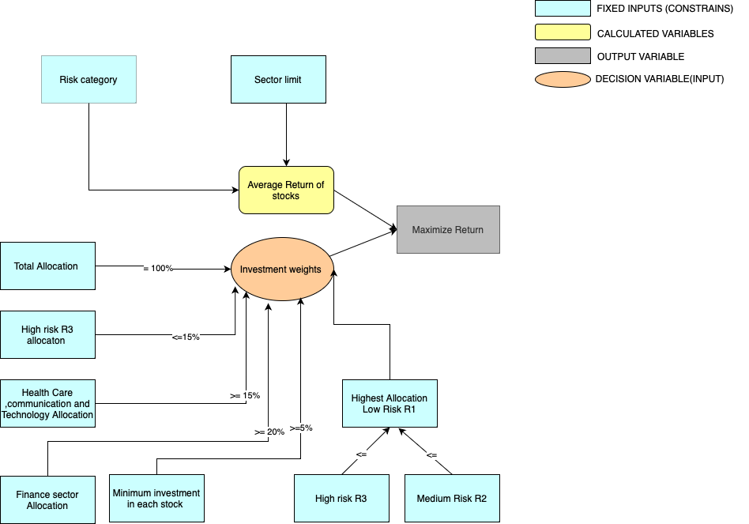
Conceptual Diagrams for Linear Programming

Slide 8
Linear Programming Algebraic Formulation
The objective is to Maximize:
Si is denoted as stock ,si=(11,12,21,22,31,32,41,42)
Z = 10s11 +5s12 +10s21 +5s22 +10s31 + 5s32 + 5s41+ 10s42
Subject to:
s11 +s12+s21+s22+s31+s32+s41+s42 = 100% ( Sum of all investments should equal 100% or 1 of the portfolio)
s11+s12 <= 15% (High Risk assets should be less Than 15%)
s31+s41+s42 >= s21+s22+s32 (Low risk stocks should be greater than Medium Risk stock(R2)
s11+ s12 >=15% ( Health care sector must have a minimum investment of 15% )
s21+s22>=15% ( Technology sector must have a minimum of 15% invested )
s31+s32>=15% (Communication Service sector must have a minimum of 15% invested)
s41+s42>=20% (Finance sector must have a minimum of 20% invested)
s11>=5%, s12>=5%,s21>=5%,s22>=5%,s31>=5%,s32>=5%,s41>=5%,s42>=5% (minimum investment in each Stock should be 5%)
s11,s21,s21,s22,s31,s32,s41,42 >= 0 (Non -negative Constrain )

Slide 9
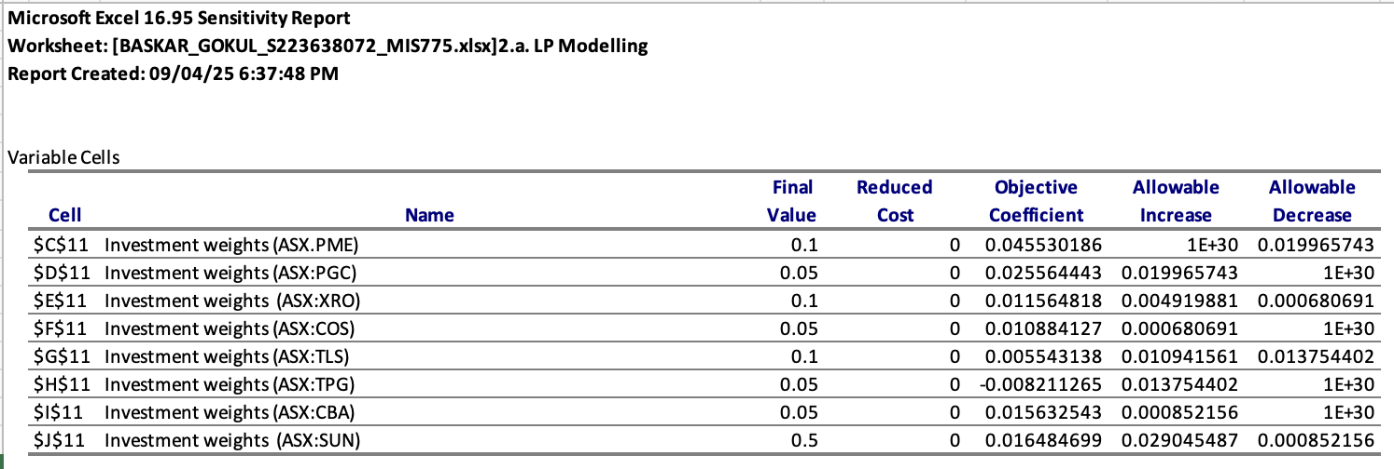
LP Model – Sensitivity Analysis
Interpretation of Variable Cells (Objective Coefficients)
Each row in the variable cell section of the sensitivity report shows how the optimal solution will behave if the objective coefficient (return per unit of investment) for a particular investment changes.
For example, if the objective coefficient for ASX:PME increases or decreases within a certain range (called Allowable Increase and Allowable Decrease), the current optimal investment decision remains unchanged.
If Allowable Increase is extremely large (like 1E+30), it indicates that the objective coefficient can increase infinitely without affecting the current optimal solution—meaning the investment is already at its optimal point.
For the Allowable Decrease, if it is, say, 0.020, it means the objective coefficient can decrease by up to 0.020 without changing the optimal solution. If it decreases more than that, re-run the Solver.

Slide 10
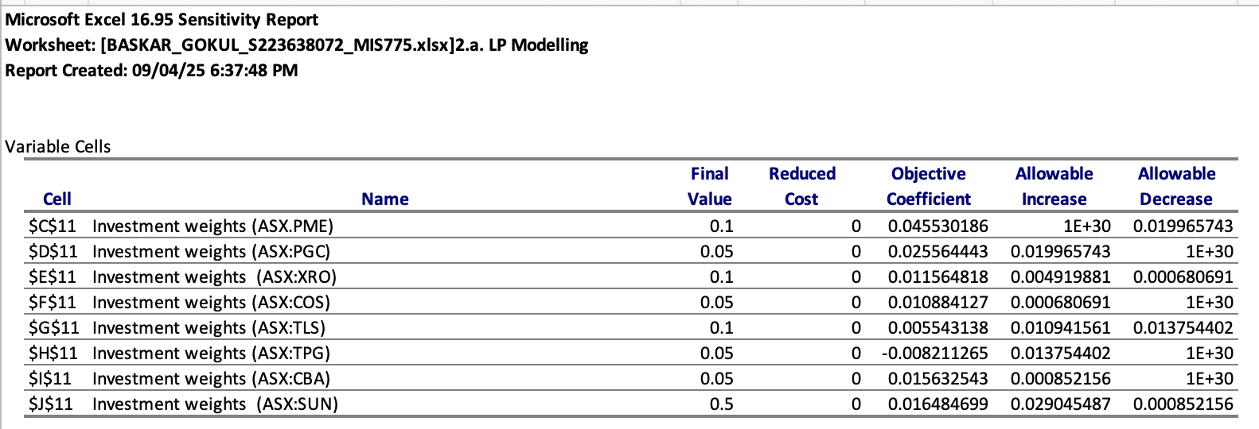
LP Model – Sensitivity Analysis
Reduced Costs: The report provides reduced costs for the decision variables, indicating how much an asset’s return would need to improve to get more than its current allocation (for those at minimum):
Assets at their 5% floor (e.g. PGC, COS) have reduced costs equal to the amount their return falls short of the portfolio’s marginal return. For instance, if Cosol’s expected return were higher by any percentage, the model would allocate more to COS above 5%. Conversely, assets already above minimum (SUN, TLS, PME, XRO) have zero reduced cost – they are already included to the extent justified by their returns.
Because every asset is included (none at zero weight), the reduced costs in this model mainly reflect the cost of increasing an asset’s weight from the minimum to a higher value. E.g., to increase CBA from 5% to 6%, its return would need to increase enough to overcome the fact that it’s currently constrained by lower attractiveness relative to SUN or others.

Slide 11
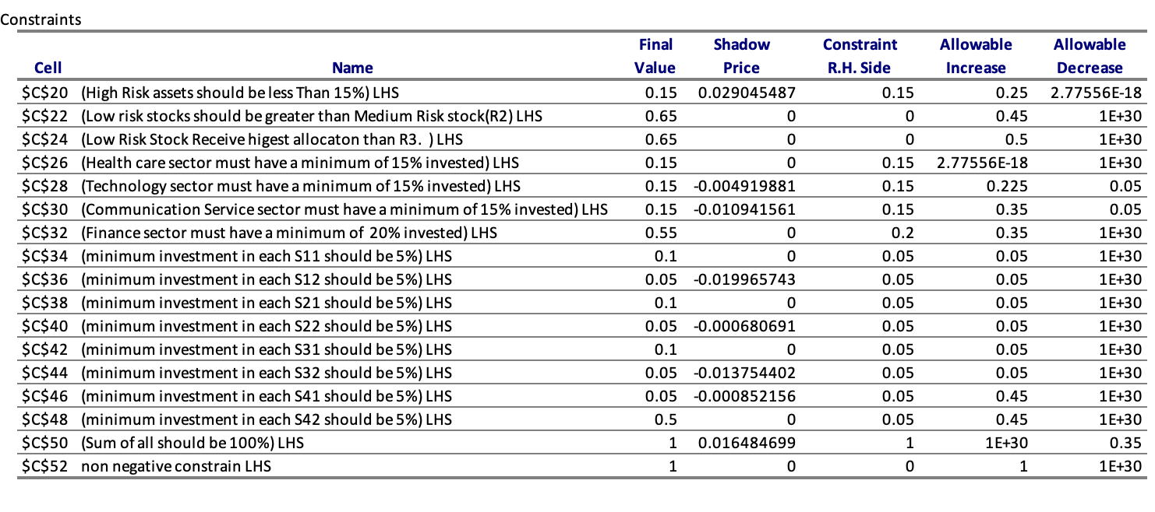
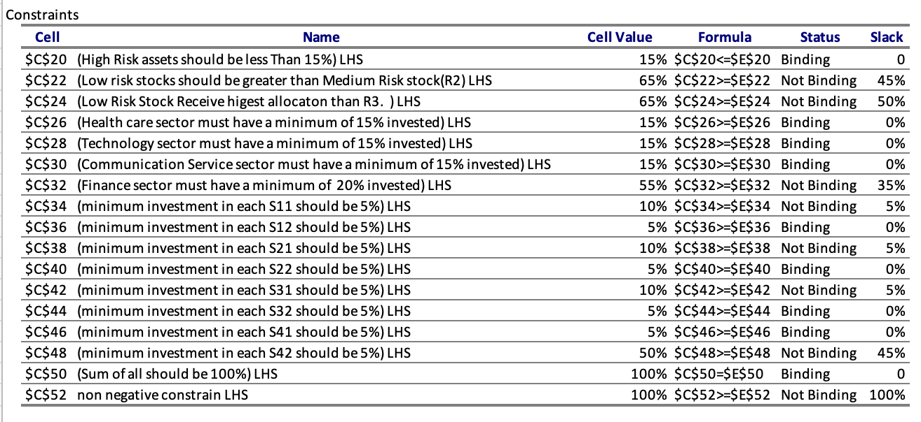
LP Model – Sensitivity Analysis
Interpretation of Constraints (Sensitivity Report for Constraints)
1. Binding vs. Non-Binding Constraints:
A binding constraint is one where the available resource is fully used—no slack.
Shadow Price > 0 indicates a binding constraint.
A non-binding constraint means there is still some unused resource (slack or surplus).
Shadow Price = 0 indicates a non-binding constraint.
2. Slack and Surplus
For ‘≤’ constraints, any unused capacity is shown as Slack.
For ‘≥’ constraints, the extra (unused) requirement is shown as Surplus.
3. Shadow Price:
The Shadow Price represents how much the objective function (total return) would change if the Right-Hand Side (RHS) of a constraint increases by one unit
A Negative shadow price increase in RHS will Decrease the optimal solution.
Non-binding constraints (like the Financials min, which wasn’t tight) have zero shadow price – loosening or tightening them slightly would not affect the solution.

Slide 12
LP Model – Sensitivity Analysis
Excel Solver Sensitivity Report for the LP model. It lists each constraint with its shadow price illuminating how changes would affect the optimal solution.
Binding Constraints: Several constraints are binding (active at equality) in the LP solution, meaning they directly restrict the objective:
The High-Risk cap (15%) is binding – R3 assets total exactly 15%. This indicates the solution would have liked to invest more in high-risk stocks (if profitable) but was stopped by this cap.
All sector minimum constraints for S1, S2, S3 (15% each) and S4 (20%) are binding (each of those sectors ended up at exactly the minimum required allocation). This reveals the model only invested the forced minimum in Health, Tech, and Comm sectors; it would have allocated even less to those sectors if allowed, preferring to put more into Financials (which exceeds its 20% min). The Financials sector ended at 55%, well above its 20% minimum (not binding).
The 5% per-asset minimum is binding for four assets (PGC, COS, TPG, CBA each at 5%) . These stocks are at their lowest allowed allocation – implying they were the least attractive in the optimal mix (the solver would reduce them further if it could).

Slide 13
LP Model – Sensitivity Analysis
Example 1:
For example, constraint 1.“High-risk investments ≤ 0.15”: The portfolio’s return could increase – the model would invest a bit more in high-return high-risk assets. This reflects an appetite to take slightly more risk for gain, if permitted.
If the RHS increases by 0.01 (i.e., allowing more high-risk investments), the optimal solution (total return) increases by 0.02.
This benefit continues up to an allowable increase of 0.25, beyond which the shadow price might change or become invalid.
Example 2:
For example, An Increase in the Constrain of the Minimum investment in communication Sector of 15%.
If the RHS increased by 0,01 can decrease the optimal value of -0.01.
The binding sector minimum constraints have negative shadow prices. For example, the shadow price for the 15% IT sector constraint is negative, meaning if we could lower that requirement (invest less in IT), the optimal value would increase (we’d free capital to invest in better-performing sectors). Similarly, requiring 15% in Health and Comm had a small opportunity cost. In essence, these shadow prices quantify the return “penalty” of having to invest that 15% in those sectors.

Slide 14
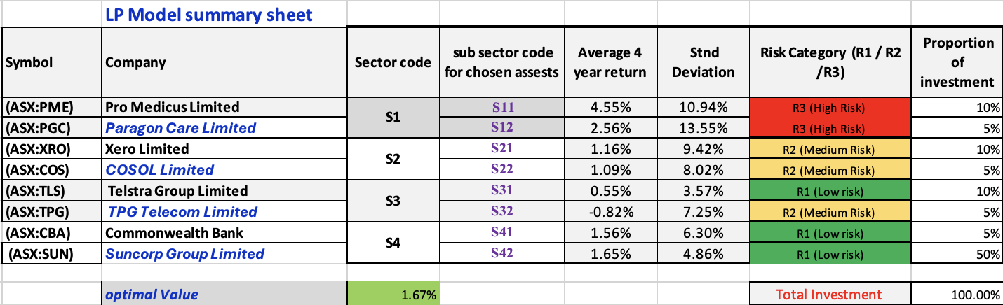
LP Model – Sensitivity Analysis
Insights from Sensitivity: The analysis shows the return is most sensitive to the High-Risk allowance. The binding 15% R3 cap suggests that relaxing it could improve returns – the model likely would invest more in a high-return (but high-risk) asset if allowed. On the other hand, the tight sector requirements forced inclusion of some lower-return sectors; if those requirements were eased, the model would concentrate even more in the best-performing sector (Financials). However, such concentration was intentionally limited to maintain diversification.
In summary, the binding constraints ensure the solution remains diversified and low-risk, but they come at the cost of some foregone return (as indicated by the shadow prices).

Slide 15
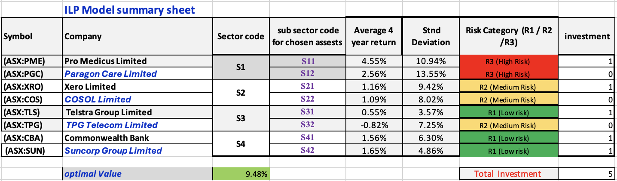
ILP Optimisation Model
Optimal ILP portfolio composition – the 5 selected stocks (remaining 3 stocks receive 0%).
Selected Assets (5): The ILP optimization chose the following five stocks for the portfolio:
Suncorp (SUN) – Financials, Risk Group R1
Commonwealth Bank (CBA) – Financials, Risk Group R1
Pro Medicus (PME) – Health Care, Risk Group R2
Xero (XRO) – Information Tech, Risk Group R2
TPG Telecom (TPG) – Comm Services, Risk Group R3
The portfolio’s total expected return is 9.48% (this figure represents the average return of the 5-stock portfolio.Notably, this return is much higher than the LP model’s return, reflecting the more aggressive asset selection.

Slide 16
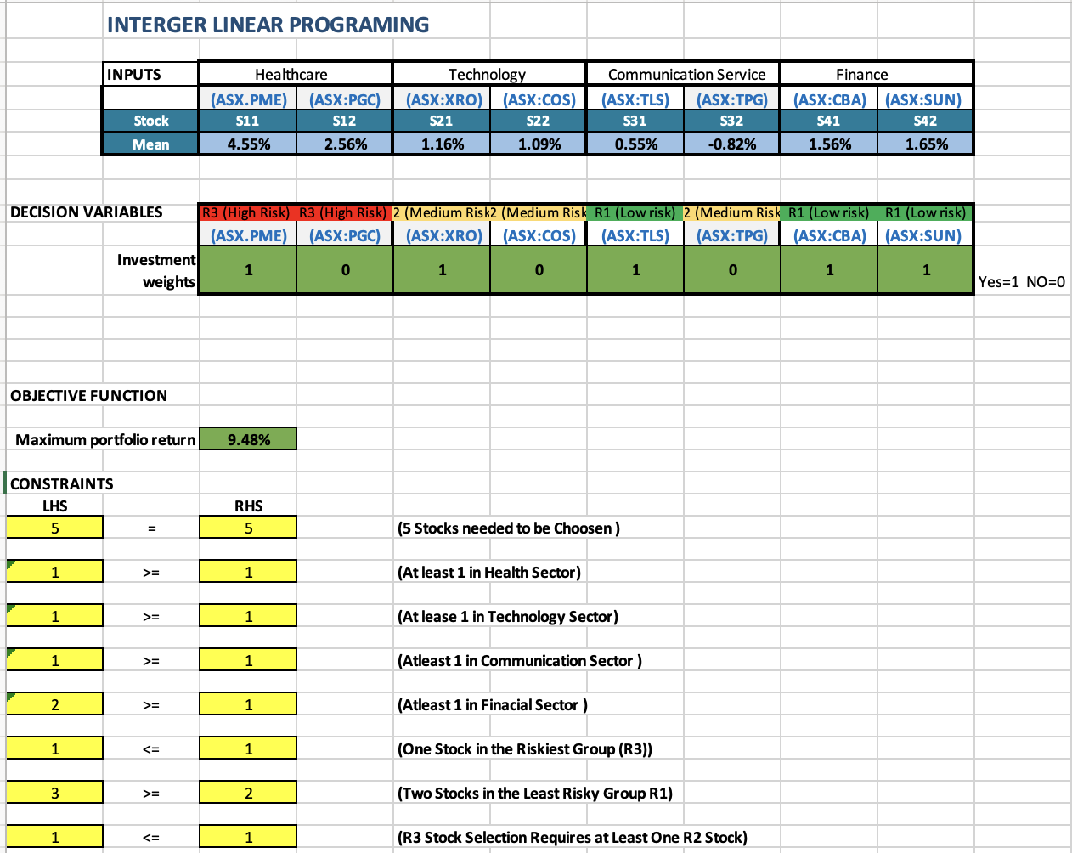
ILP Optimisation Model
Verification of Constraints: All ILP constraints are satisfied:
All four sectors are represented (Health: PME; IT: XRO; Comm: TPG; Finance: SUN & CBA). Finance is the only sector contributing two stocks (which is allowed, and no sector has more than 2 picks).
Exactly 5 stocks are chosen.
Risk composition: 2 low-risk (SUN, CBA in R1), 2 medium-risk (PME, XRO in R2), 1 high-risk (TPG in R3). This meets the “≥2 R1, ≤1 R3, and if R3 then ≥1 R2” criteria – we have one R3 (TPG) accompanied by two R2 stocks, and we have more than the required minimum of R1 stocks.
Excluded Assets: Telstra (TLS), Paragon Care (PGC), and Cosol (COS) were not selected. These excluded stocks are the ones the model deemed less beneficial to the portfolio’s return given the constraints. TLS (Comm, R1) is very low risk but likely offered a lower return than CBA or SUN, so the model chose the two financial R1s over it. PGC and COS (both R3 stocks in Health and IT respectively) were high risk and their returns did not surpass those of the chosen assets enough to justify inclusion under the “at most one R3” rule (the one R3 slot was given to TPG, presumably because TPG had the highest return potential among R3 candidates).

Slide 17
ILP Optimisation Model
Interpretation: The ILP optimal solution is a more concentrated portfolio, focused on the top-performing stocks in each sector/risk category combination. It Favors:
The Financials sector heavily (40% of the portfolio split between two strong performers, SUN and CBA – reflecting the higher returns from finance stocks in the period).
Growth-oriented picks in Health and Tech (PME and XRO) that had high returns, rather than their small-cap counterparts.
Only one Communications stock (TPG) – interestingly, the ILP chose the riskier telecom (TPG, R3) over Telstra (R1), suggesting TPG’s return was sufficiently high to take on its risk, especially since other constraints enforced overall balance.
The resulting ILP portfolio has a balanced risk mix (two R1, two R2, one R3), but it is less diversified than the LP portfolio (only 5 stocks instead of 8). This allowed it to achieve a higher return, as it did not have to include every low-return asset.

Slide 18
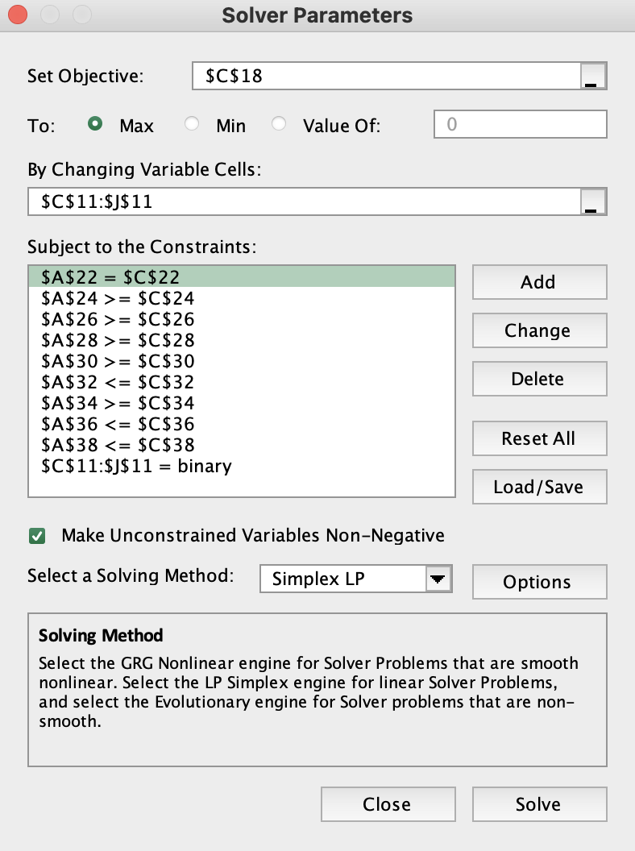
ILP Model Solver
Within this Integer linear model, the solving approach used is the Simplex LP method.
the decision variables are binary (either 0 or 1), this model requires the "binary" constraint to be applied. ensuring that each of the decision variables can only take values of 0 or 1 (either the stock is included or not in the optimal portfolio
The option to Make Unconstrained Variables Non-Negative is also ticked to avoid any negative values in the decision variables, which would be unrealistic in this case (as investment weights cannot be negative)

Slide 19
ILP Algebraic Model
ILP Portfolio:
xi denote the binary decision variable for including stock in the portfolio,
xi=1 if stock is included, otherwise xi​=0
Stocks denoted as si=11,12,21,22,31,32,41,42)
Objective Function : max Z= ∑8si=1(xi​)
Subject to:
∑ 8si=1(xi=5) (5 Stocks need to chosen )
s11+s12 >=1 (Alease 1 stock from Health sector)
s21+s22 >=1 (Alease 1 stock from Technology sector)
s31+s32>=1 (Alease 1 stock from Communication sector)
s41+s42 >=1 (Alease 1 stock from finance sector)
s11+s12 <=1 (At most 1 stock from the highest-risk)
s31+s41+s42 >=2 (At least 2 stocks from the lowest-risk group)
s11+s12 <= s21 +s22+s32 ( If any high-risk stock is selected, then at least one medium-risk stock selected

Slide 20
LP And ILP Model Comparison
Criteria | LP Model | ILP Model (Select 5 Stocks)
Portfolio Composition | All 8 stocks included (each ≥5%) – very broad diversification. | 5 best stocks selected; 3 stocks excluded entirely. Focused allocation.
Weight Distribution | Uneven weights (from 5% up to 50%). One stock (SUN) got half the portfolio; others at min share. | Equal 20% per selected stock (by design). No single stock over 20%.
Return Achieved | Total return 1.67% Lower return due to constraints forcing some low-return investments. | The Total return 9.48% Significantly higher overall return by concentrating on higher-return assets.
Risk Profile | Very conservative: 65% in low-risk assets (R1), only 15% in high-risk (R3). Satisfies R1 ≥ R2,R3 by wide margin. | Moderately conservative: contains an R3 stock (20% of portfolio) but also two R1 stocks (40%). Satisfies all risk rules with a balanced mix.
Sector Allocation | Each of 4 sectors ≥15% (met exactly for 3 sectors; Financials 55%). Ensures broad sector coverage but heavy tilt to Financials. | All 4 sectors represented (min 1 stock each). Financials ended 40% (2 stocks). Sector diversity maintained, though not equal (one sector doubled).
Model Nature | Linear programming (fractional decisions). Solution tends to spread across many assets due to minimum constraints. | Mixed-integer programming (discrete choices). Solution picks a limited set of assets for a higher return focus.
Advantages | Highly diversified -> reduces unsystematic risk. Fulfills all diversification criteria strictly. Straightforward to implement mean–return optimization in LP. | Higher return potential by skipping less attractive assets. Simpler portfolio to manage (only 5 stocks). Respects diversification in a broader sense (all sectors, risk mix) without over-diluting returns.
Disadvantages | Lower return : includes some low-yield stocks due to constraints (mandatory minimums). Over-diversification: every asset gets a piece even if not optimal. | Less diversification : higher specific risk (fewer stocks). Needs integer programming (more complex solving). Excludes some sectors’ secondary picks entirely (no minor positions as in LP).

Slide 21
Preferred Strategy & Rationale
Preferred Model: The ILP-based strategy (selective portfolio) is preferred for this investment scenario, because it yields a markedly higher return while still respecting essential risk diversification guidelines.
Rationale: The ILP portfolio achieved 9.48% return compared to the LP’s 1.67% monthly . This improvement is because the ILP model was free to exclude low-return assets. By allowing zero-weight holdings, the ILP model avoids investing in assets that would dilute returns through over-diversification. It focuses capital on a curated set of high-performing stocks, which is a more effective use of risk budget.
Diversification vs Performance: The LP approach might be suitable for an extremely risk-averse mandate (where every possible asset must be held to spread risk). However, in most practical cases, holding a subset of assets can achieve adequate diversification. The ILP’s constraints (≥1 per sector, etc.) ensured the portfolio is not overly concentrated or one-dimensional. Therefore, the ILP strikes a better balance: it diversifies across key sectors and risk bands without unnecessarily sacrificing return.
Conclusion on Strategy: The ILP model demonstrates that a constrained stock selection approach can lead to a superior efficient portfolio. It delivers a higher expected return for the given risk constraints, which is typically the investor’s goal. Thus, the ILP portfolio is the recommended investment strategy out of the two.

Slide 22
Conclusion
In this assignment, we formulated two models to optimize an investment portfolio and learned how different constraints impact the outcome:
The LP model gave a highly diversified portfolio that strictly adhered to all imposed limits but achieved only a modest return. It highlighted the effect of tight constraints – many were binding, indicating the portfolio was pushed to the edges of the requirements (e.g., every sector got the minimum allowed, high-risk was capped, etc.). This model emphasizes capital preservation and broad exposure.
The ILP model provided a clearer view of which assets truly add value. By selecting only 5 stocks, it essentially performed a filtered optimization, leading to a much higher return while still managing risk. This showed the benefit of relaxing the diversification at the individual asset level (as opposed to at category level) – we don’t need to hold every stock to be diversified.
Key Insights: Optimal solutions depend heavily on constraints:
Forcing small allocations to all assets (as in LP) ensures no single asset can hurt the portfolio much, but it also ensures many low-return contributors drag the average down. This is a cautious strategy suitable for risk minimisation but not return maximisation.
Allowing the model to drop assets (as in ILP) can greatly enhance performance, as seen by the ILP’s use of only the best assets. Proper constraints (sector, risk group requirements) are crucial to prevent the ILP from chasing return with an undiversified or overly risky set of picks.
Sensitivity analysis of the LP model revealed which constraints “cost” the most in terms of forgone return (e.g., the high-risk limit). This kind of insight is valuable; if an investor’s risk tolerance increased, relaxing certain constraints could noticeably improve returns. Conversely, it showed that some constraints (like requiring low-risk dominance) were not actually limiting the LP solution (it naturally favoured low-risk heavily).

Slide 23
Conclusion
Recommended Action: For an investor with moderate risk tolerance, the ILP portfolio is the more efficient choice. It achieves a better return for the risk and meets all policy constraints (diversification across sectors and risk categories). The analysis underscores that thoughtful constraint design and model selection (LP vs ILP) can lead to very different portfolio recommendations. In practice, a combination of these approaches might be used: start with a broad LP for insight, then apply integer constraints to fine-tune the selection for better performance.
Ultimately, this exercise demonstrated how decision modelling can aid in portfolio optimisation – providing a structured way to balance return and risk, test scenarios (via sensitivity analysis), and arrive at a data-driven investment decision. The ILP’s outcome, in particular, suggests a more concentrated yet diversified strategy can be optimal, aligning with the principle that one should diversify across asset classes and risk factors, but not necessarily invest in every available asset. The results support a targeted investment approach guided by both quantitative analysis and prudent constraints.

Slide 24
Thank you

